Slide 1
Random variables

Slide 2
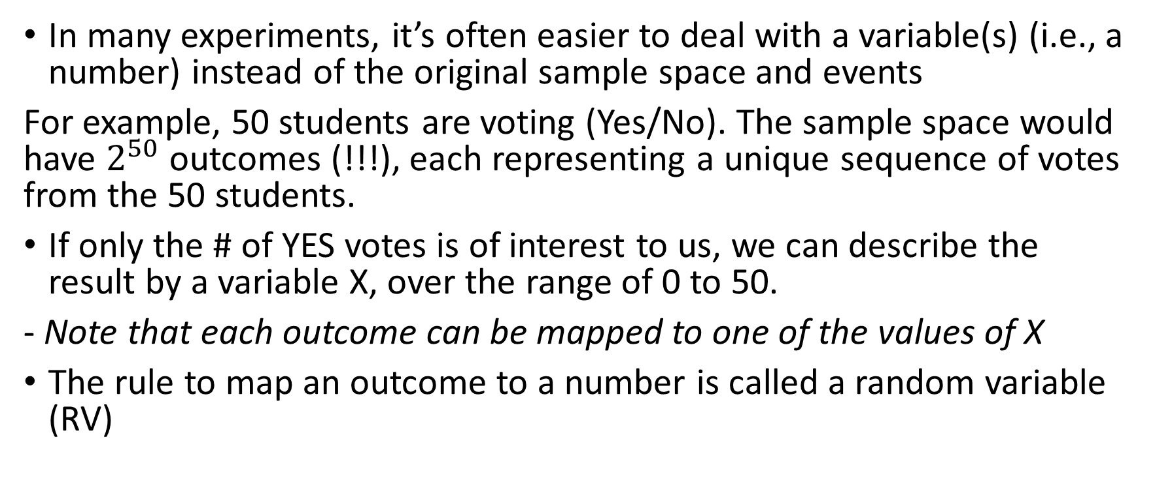
Random variables
In many experiments, it’s often easier to deal with a variable(s) (i.e., a number) instead of the original sample space and events
For example, 50 students are voting (Yes/No). The sample space would have $2^{50}$ outcomes (!!!), each representing a unique sequence of votes from the 50 students.
If only the # of YES votes is of interest to us, we can describe the result by a variable X, over the range of 0 to 50.
- Note that each outcome can be mapped to one of the values of X
The rule to map an outcome to a number is called a random variable (RV)

Slide 3
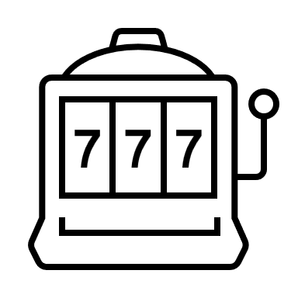
Random variables
A random variable (RV) is a mathematical function mapping each outcome in the sample space to a number
The probabilities for different values is its probability distribution (=value of RV & the corresponding probabilities)
Sample space
RV
Hello,
I am an outcome
-2 -1 0 1 2 3 4 5 6 7 8 9 10

Slide 4

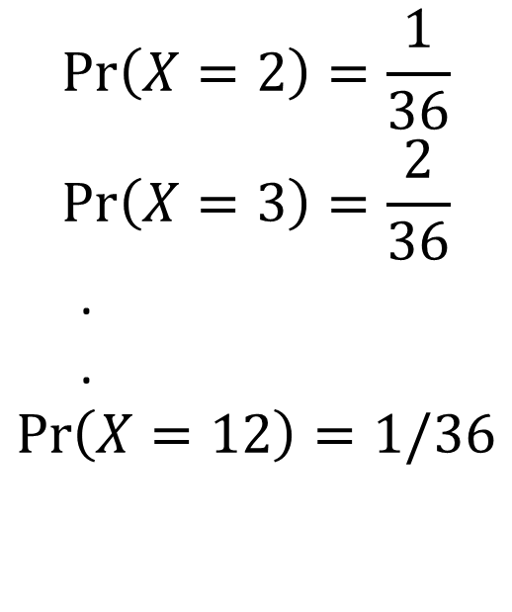
For an experiment of throwing a fair dice twice, define a random variable X = the sum of the two numbers.
$$S=\{\left(1,1\right),\left(1,2\right),…., \left(6,4\right),\left(6,5\right),(6,6)\}$$
X | 2 | 3 | 4 | 5 | 6 | 7 | 8 | 9 | 10 | 11 | 12
Frequency | 1 | 2 | 3 | 4 | 5 | 6 | 5 | 4 | 3 | 2 | 1
probability | 1/36 | 2/36 | 3/36 | 4/36 | 5/36 | 6/36 | 5/36 | 4/36 | 3/36 | 2/36 | 1/36
Distribution of X (mathematical form)
Distribution plot
$$\operatorname{Pr}\left(X=2\right)=\frac{1}{36}$$
$$\operatorname{Pr}\left(X=3\right)=\frac{2}{36}$$
.
.
$$\operatorname{Pr}\left(X=12\right)=1/36$$

Slide 5
Properties of the distribution of an RV
Expectably, a probability distribution must inherit the classical properties of probabilities:
1) The probability for any RV value must be between zero and one
2) The total probability of a distribution is 1.0

